Slide 1



Credit Card Approval Analysis

Slide 2

Introduction
The financial industry relies heavily on credit scoring models to assess the creditworthiness of applicants and make informed decisions about issuing credit cards.
Many applicants are rejected for various reasons, such as low income levels or too many inquiries on an individual’s credit report.
The objective of this project is to develop a prediction model that determines whether an applicant is a 'good' or 'bad' client.
This analysis helps us to optimize risk management, improve fairness and operational efficiency.

Slide 3
Target Audience
Our potential audience will be:
Financial Institutions
Credit Card Issuers
Consumer Protection Agencies.
Our analysis will assist financial institutions and credit card issuers by reducing default rates, streamlining the credit card approval process, and ensuring fairness in lending practices.

Slide 4
Diving into our Dataset
The dataset is taken from a financial institutions and it consists historical data of approved credit card applicants
Some of the attributes that we considered for our analysis are -
Applicant age – indicating age of individual
Employment status – represents which type of employment
Family type and Family count – indicates number of people in the applicant's family
Educational level – denotes kind of education applicant has pursued
Properties owned – indicates realties and assets owned by applicant
And so on...

Slide 5
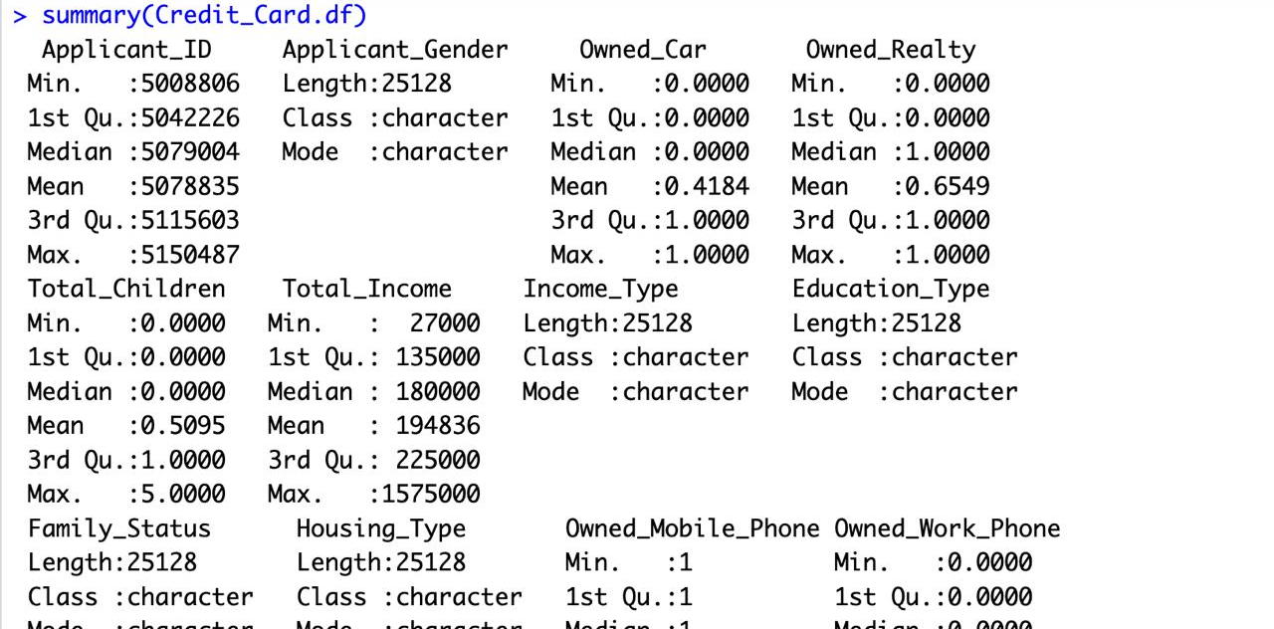

Slide 6
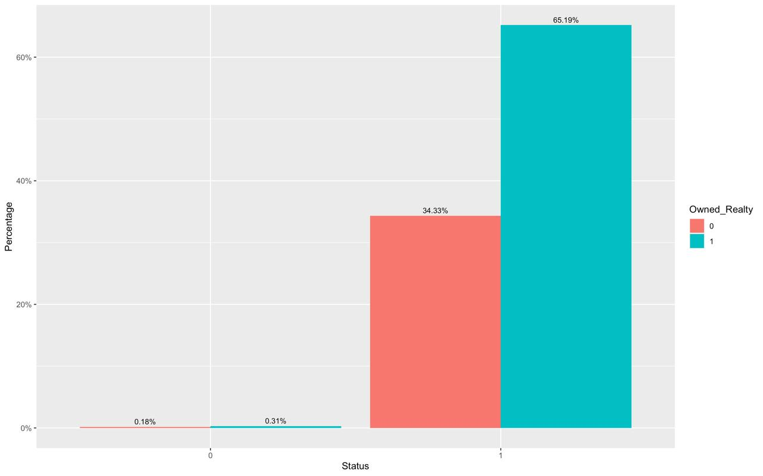
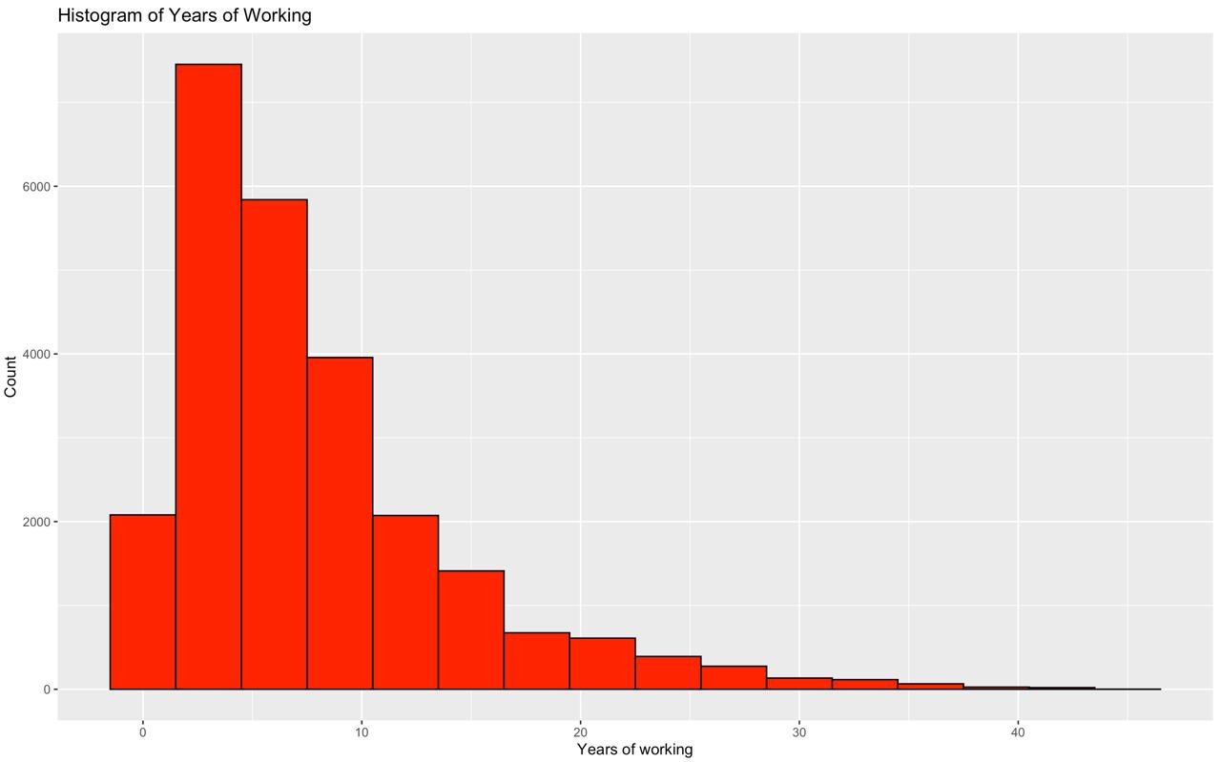
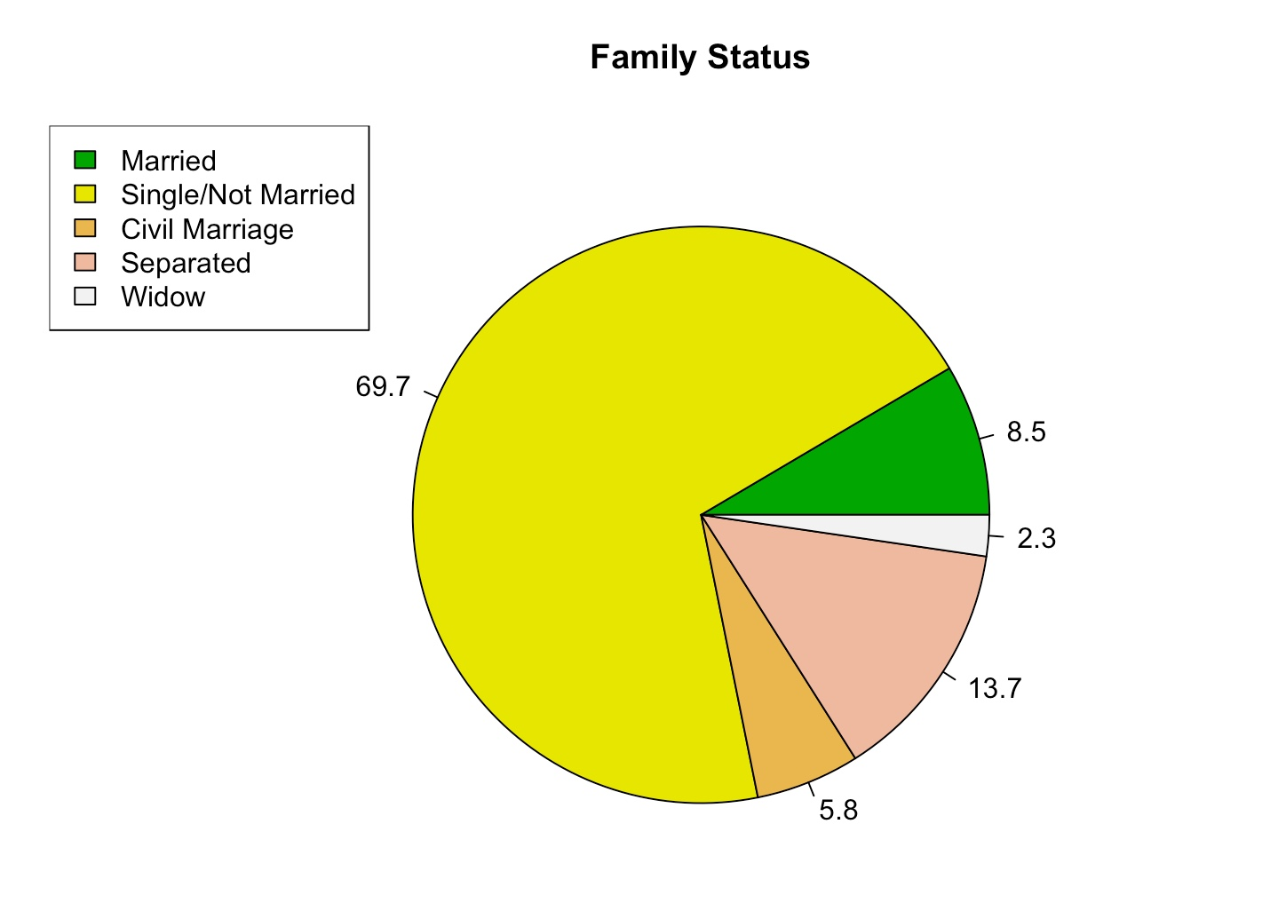
Exploratory Data Analysis
The graph shows a dominant 69.15% of customers own real estate, while very few rent or live with parents, indicating property ownership is prevalent among this group.
The histogram indicates that most individuals possess 0 to 10 years of work experience, predominantly within the 0–5 year bracket.
Most applicants are married, but while there are more separated applicants than widowed ones, the latter group appears to pose a higher risk.

Slide 7
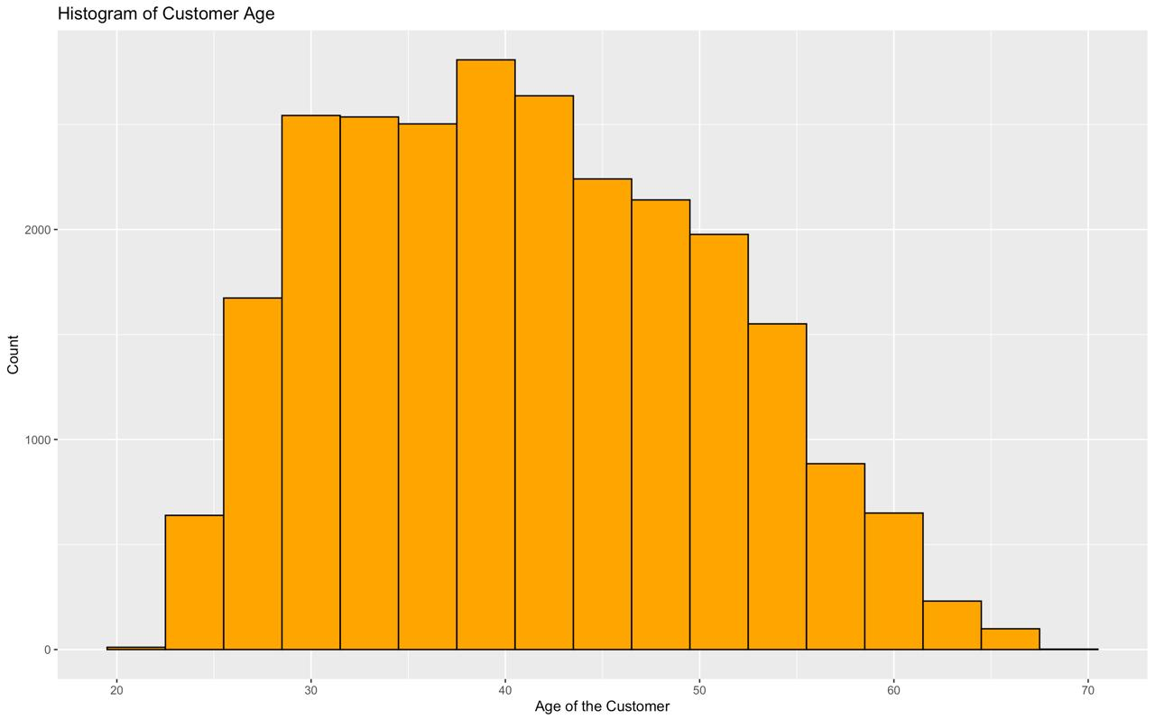
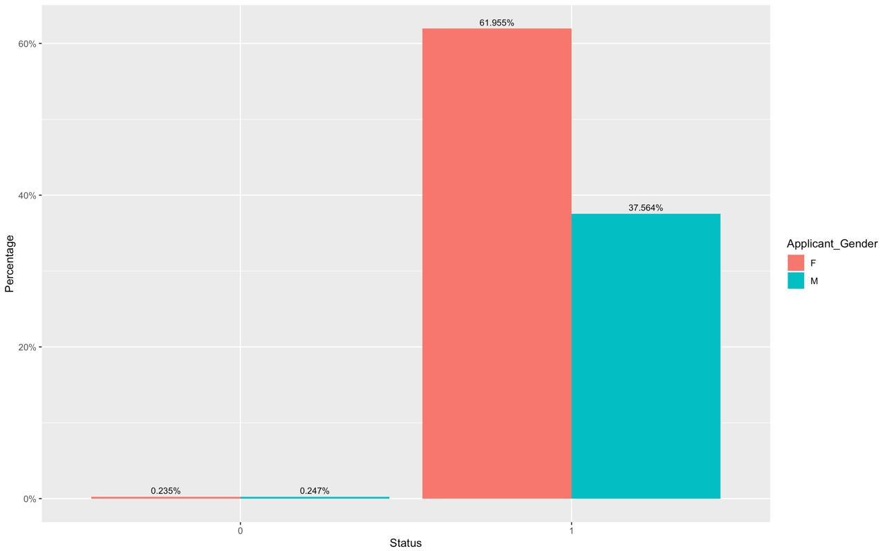
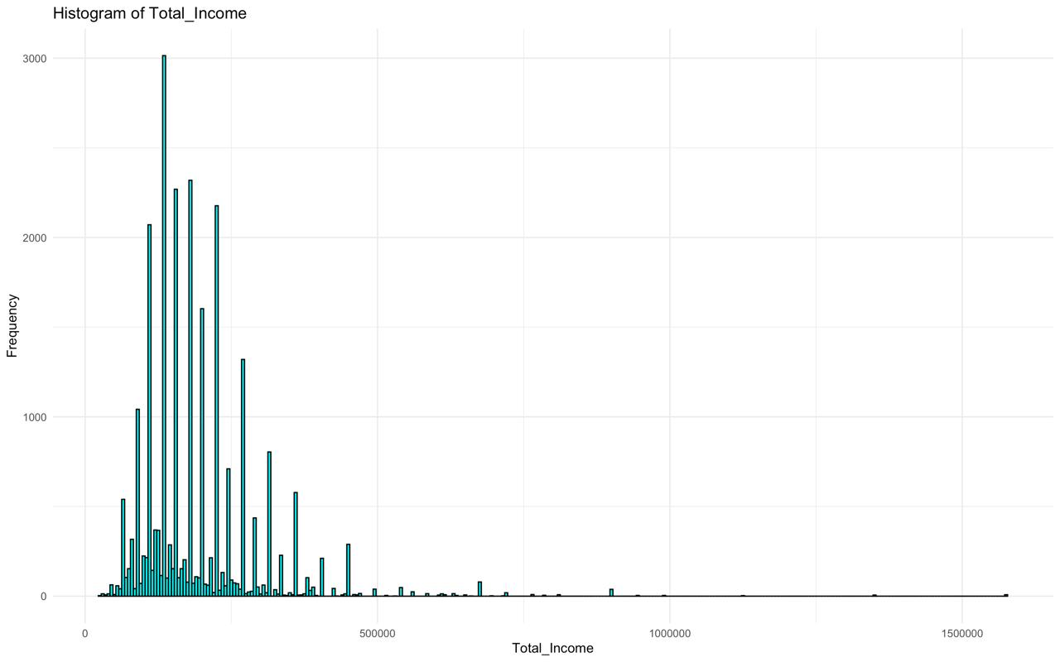
The histogram suggests a youthful customer age profile, peaking between 30 to 40 years and tapering off beyond 40.
We have more female applicants than male
The histogram displays a high number of individuals with low incomes and a few with much higher earnings, as shown by the left-skewed distribution with a long right tail.

Slide 8
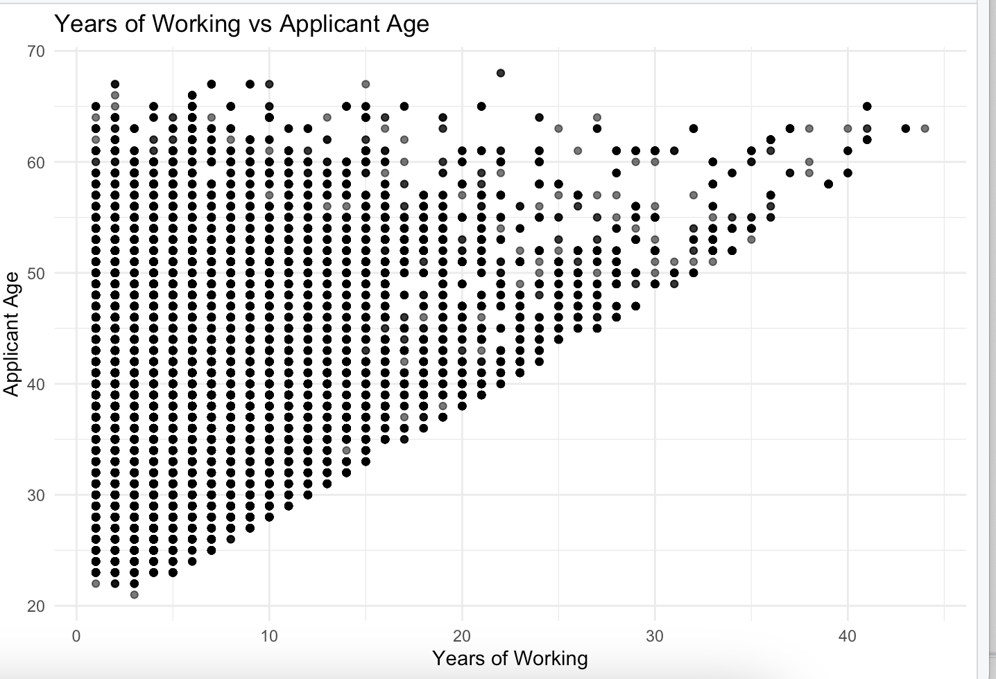
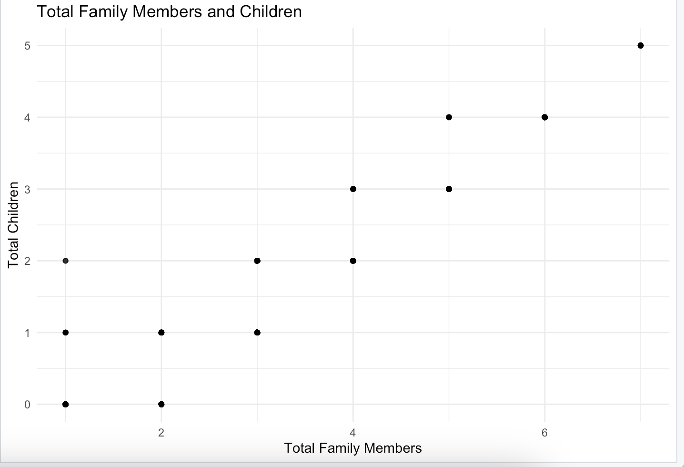
The graph “Years of Working vs Applicant age” reveals a workforce aged 30-70, with up to 40 years of experience, skewed towards younger, less experienced individuals.
The graph “Total Family Members and Children” indicates small families prevail, typically with fewer than 4 members and 2 children.

Slide 9
Data Preprocessing
Prior to modeling our data, it's essential to ensure its cleanliness by addressing missing or erroneous values, as well as identifying and managing outliers.
We have used One hot encoding for Categorical variables to avoid ordinality, Min Max Scaling to shrink the data range from 0 to 1 and Ordinal encoding.

Slide 10
Logistic Regression Model
The logistic regression model shows strong performance with a training accuracy of 96.6% and testing accuracy of 95.6%.
Model | Testing Accuracy % | Training Accuracy%
Logistic Regression | 0.956019 | 0.9665025

Slide 11
Decision Tree
The Decision tree model achieved a high training accuracy of 98.07% but shows a reduced testing accuracy of 97.09%, which may suggest overfitting.
Model | Testing Accuracy % | Training Accuracy%
Decision Tree | 0.97090873 | 0.98073561

Slide 12
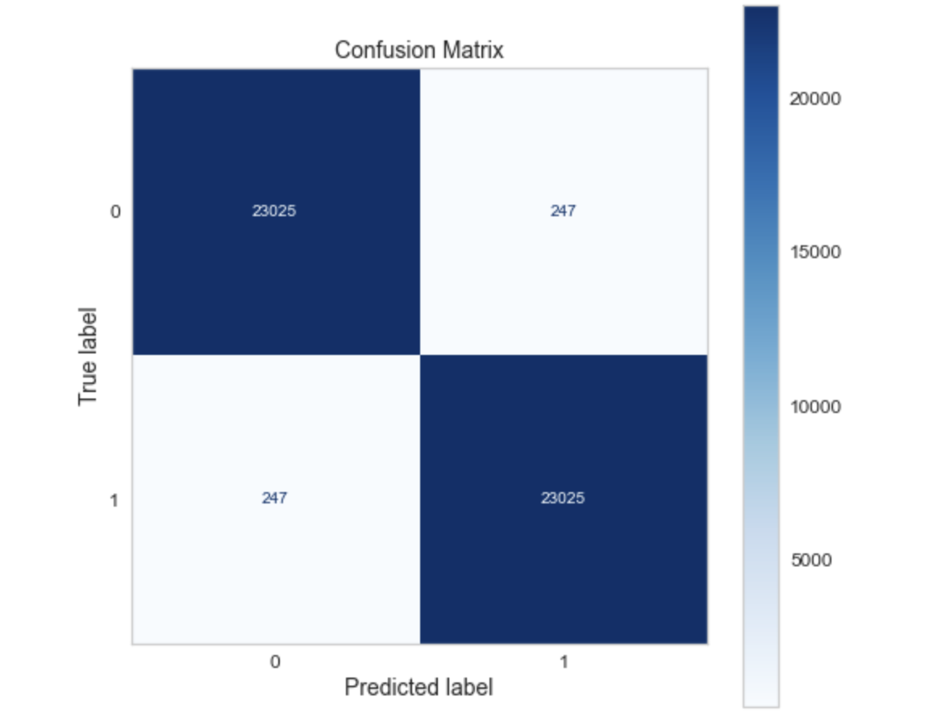
Random Forest Classifier
The Random Forest model exhibits high training accuracy at 99.07% but a lower testing accuracy of 98.79%, indicating a potential overfit to the training data.
MODEL | TESTING ACCURACY % | TRAINING ACCURACY%
Random Forest Classifier | 0.98790873 | 0.99073561

Slide 13
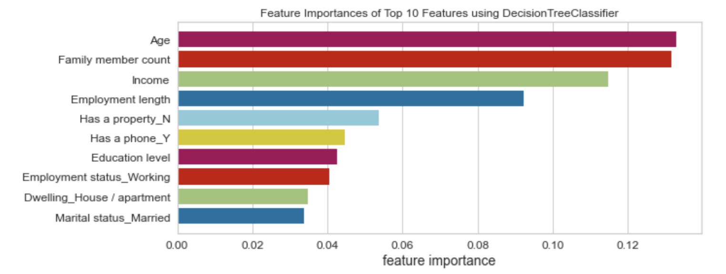
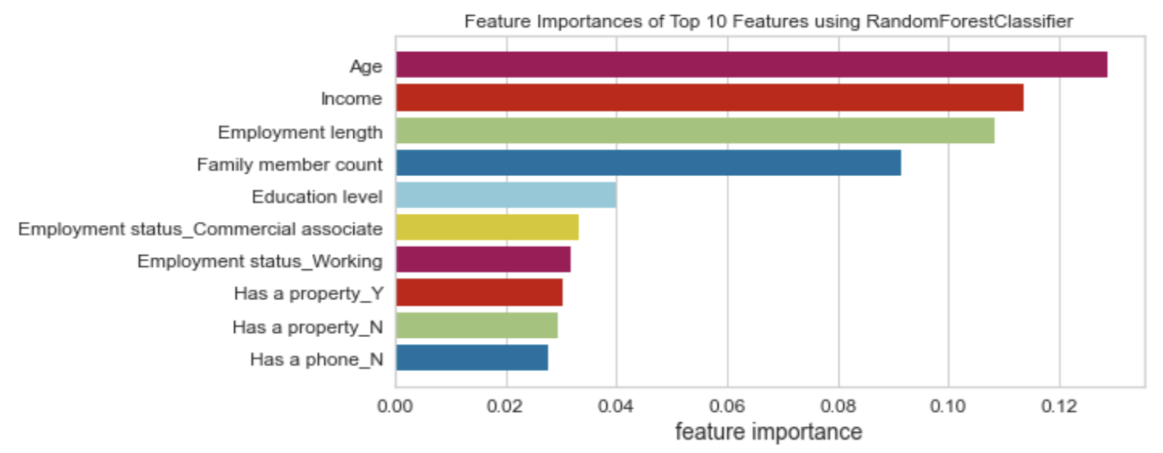
Feature importances of the top 10 features determined by a Decision Tree Classifier and Random Forest algorithm.
Feature importance scores can provide insight into the relative significance of the input features when predicting the target variable, in this case "Status

Slide 14
Insights
For a financial institution to approve a client -
Age, Family Member count, Income and Employment Length are some of the most important features to consider.
These insights might suggest that demographic and socio-economic factors play significant roles in predicting good clients.
Additionally, understanding the unique circumstances of each applicant allows financial institutions to tailor their lending products and services to meet diverse customer needs while managing risk effectively.

Slide 15
Conclusion
These insights allow banks and financial companies to make more informed decisions based on data-driven risk profiles, which can lead to a healthier portfolio of clients and a reduction in the incidence of credit default.
While these features are significant, they must be used ethically and in accordance with regulations that protect consumer rights.
Banks can use these predictions to perform Risk assessment, credit limit determination, approval process time and policy development.

Slide 16
Thank you
Dharmateja Vamisetty (DXV220010)
Shree Pragnya Sapineni (SXS220424)
Srikanth Venkateshwara Subramanian (SXV230015)
Deepa Nalla (DXN230011)

